Slide 1

CST1302 Foundation of Web Programming – Lecture 3
A. A. Datti

Slide 2
Course Outline
Introduction to WWW
Structuring and Formatting with HTML
Lists
Hyperlinks
Multimedia
Images
Audio
Video
Tables
Forms
Styling with CSS

Slide 3
HTML Elements for Lists
HTML lets you create three types of list:
Ordered lists give each item in a list a sequential number (as in 1, 2, 3). They’re handy when sequence is important, like when you list a series of steps that tell your relatives how to drive to your house.
Unordered lists are also known as bulleted lists, because a bullet appears before each item. To some degree, you can control what the bullet looks like. You’re reading a bulleted list right now.
Definition lists are handy for displaying terms followed by definitions or descriptions. For example, the dictionary is one huge definition list. In a definition list on a web page, your browser left-aligns the terms and indents the definitions underneath them.

Slide 4
HTML Elements – Ordered Lists
Sometimes, you want your lists to be ordered. In an ordered list, rather than prefixing each point with a bullet point, you can use either numbers (1, 2, 3), letters (A, B, C) or (a,b,c) and Roman numerals (i, ii, iii) or (I,II,III) to prefix the list item.
An ordered list is contained inside the <ol> element. Each item in the list should then be nested inside the <ol> element and contained between opening <li> and closing </li> tags:
<ol type="i"> <li>This is the first point</li> <li>This is the second point</li> <li>This is the third point</li> </ol>

Slide 5
HTML Elements – Ordered Lists
Ordered lists get more interesting when you mix in the start and type attributes. The start attribute lets you start the list at a value other than 1. Here’s an example that starts the counting at 5:
<p>To wake up in the morning:</p> <ol start="5"> ... </ol>
The type attribute lets you choose the numbering style. You can use sequential letters and roman numerals,

Slide 6
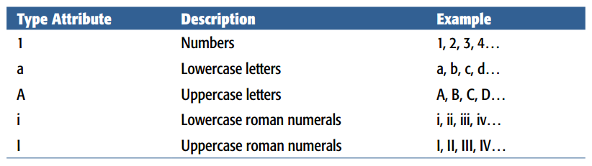
HTML Elements – Ordered Lists

Slide 7
HTML Elements – UnOrdered Lists
Unordered lists are similar to ordered lists except that they aren’t consecutively numbered or lettered.
If you want to make a list of bullet points, you write the list within the <ul> element (which stands for unordered list).
Each bullet point or line you want to write should then be contained between opening <li> tags and closing </li> tags (the li stands for list item).
<ul> <li>Bullet point number one</li> <li>Bullet point number two</li> <li>Bullet point number three</li> </ul>

Slide 8
HTML Elements – UnOrdered Lists
The type attribute, lets you change the style of bullet.
You can use disc (a black dot, which the default), circle (an empty circle), or square (a filled-in square)

Slide 9
HTML Elements – Definition Lists
The definition list is a special kind of list for providing terms followed by a short text definition or description for them.
Definition lists are contained inside the <dl> (definition list) element. The <dl> element then contains alternating <dt> (dictionary term) and <dd> (dictionary definition) elements. The content of the <dt> element is the term you will be defining.
For example: <dl> <dt>Unordered List</dt> <dd>A list of bullet points.</dd> <dt>Ordered List</dt> <dd>An ordered list of points, such as a numbered set of steps.</dd> <dt>Definition List</dt> <dd>A list of terms and definitions.</dd> </dl>

Slide 10
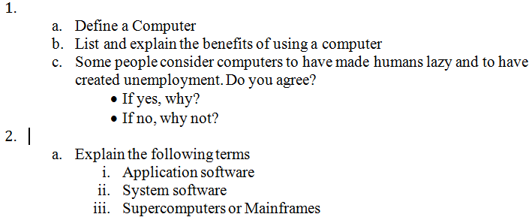
HTML Elements – Nested Lists
Consider the following:
Is it possible using what you’ve learnt about HTML Lists? How?

